Slide 1



Safeguarding NYC: Analyzing Crime Patterns using Big Data
Team Name: Data Detectives
Arsalan Anwar
ax2134@nyu.edu
MS Computer Science
New York University
Somya Gupta
sg7885@nyu.edu
MS Computer Science
New York University
Raunak Shukla
rs8668@nyu.edu
MS Computer Science
New York University
Github Repo: https://github.com/arsalananwar11/Safeguarding-NYC-Analyzing-Crime-Patterns-using-Big-Data

Slide 2

Agenda
Introduction
Key Stakeholders
Data Architecture
Findings & Insights
Challenges
Conclusion

Slide 3
Introduction
To provide an in-depth and integrated analysis of crime data from multiple sources in New York City. This study aims to identify patterns, intensities, and distributions of crimes, with the ultimate goal of aiding various stakeholders in understanding and mitigating criminal activities in NYC

Slide 4



Key Stakeholders
Regular Citizens
New York Police
Immigrants
Empowering all New Yorkers with information to understand the safety of their neighborhoods and citywide crime patterns.
Aiding in strategic deployment of officers based on crime hotspots and offering insights for potential policy changes.
Guiding them on areas and times to be cautious, ensuring their safety while they acquaint themselves with NYC.

Slide 5
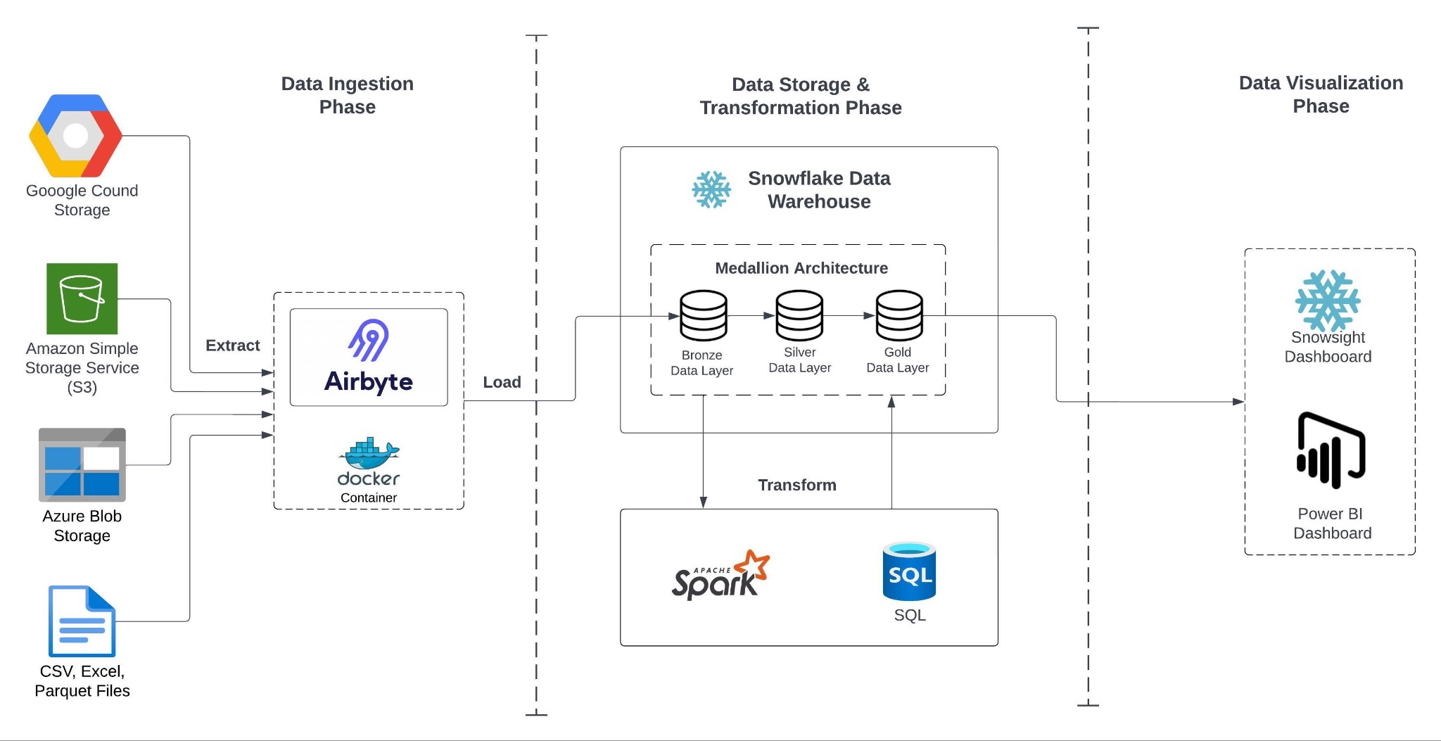
Data Architecture: Overview

Slide 6



Data Architecture: Phases and Tools
Data Ingestion Phase
Google Cloud Platform
Google Sheets
Airbyte
Docker
Data Storage and Transformation Phase
Snowflake
Spark
SQL
Data Visualization Phase
Snowsight Dashboard
Power BI Dashboard
Folium (Geospatial Mapping)

Slide 7
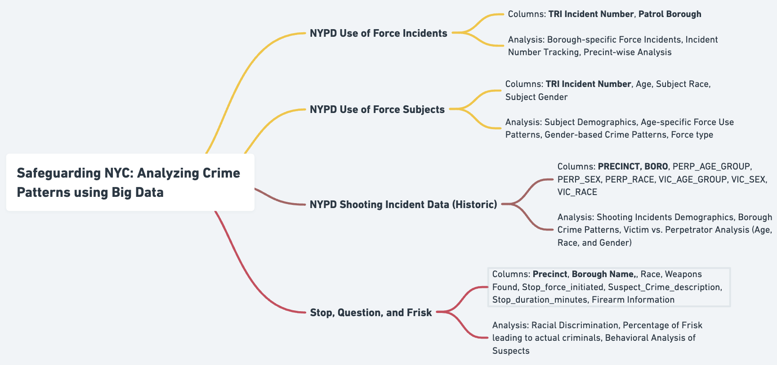
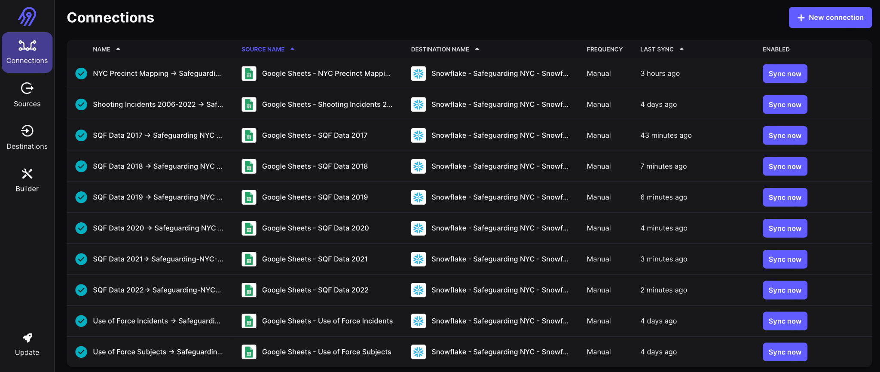
Data Ingestion Phase
Data Sources loaded from Google Cloud Platform (GSheets) (218.12k records processed)
Automatic Data Extraction and Loading through Airbyte into Snowflake

Slide 8
Data Storage Phase: Medallion Architecture
Gold Layer: Business Data
Integrated dataset with a city-wide crime perspective.
Key metrics calculated: crime rates and trends.
Prepared for decision-making and strategic insights.
1
1
1
Silver Layer Processed Data
Cleansed duplicates, standardized formats, and corrected errors.
Enhanced with geospatial and temporal context.
Structured and consistent, ready for advanced analysis.
2
2
2
Bronze Layer
Raw Data
Raw crime data ingestion from multiple NYC open datasets.
Contains unprocessed and denormalized data with redundancies.
Maintained for data provenance, replication and raw analysis purposes.
3
3
3

Slide 9
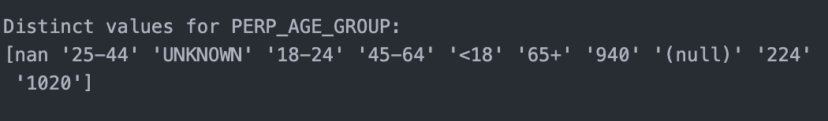
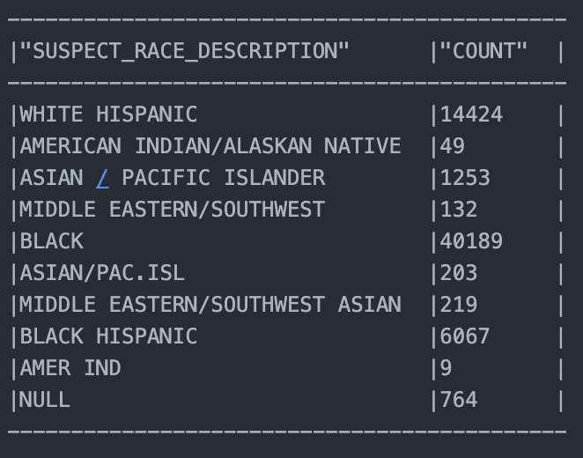
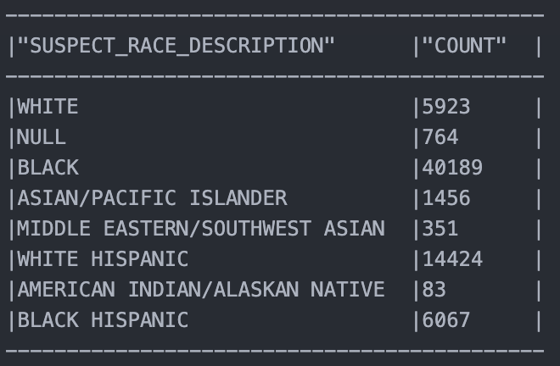
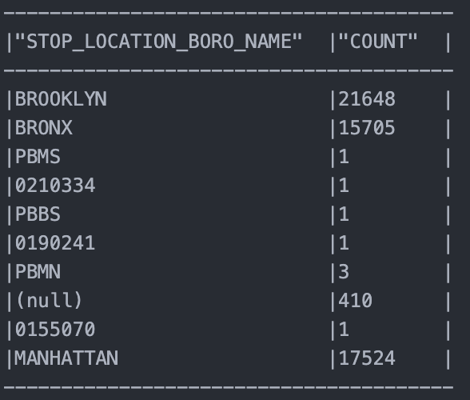
Data Transformation Phase
Outlier Removal
Dates, Weight, Height, Age
Merging and Dropping
Merged and harmonized multiple datasets, dropped unnecessary columns
Formatting for Consistency
Various data points had to be converted to the standard business format for consistency
Mapping
Null Values, Borough, Neighbourhood, Race, Gender

Slide 10
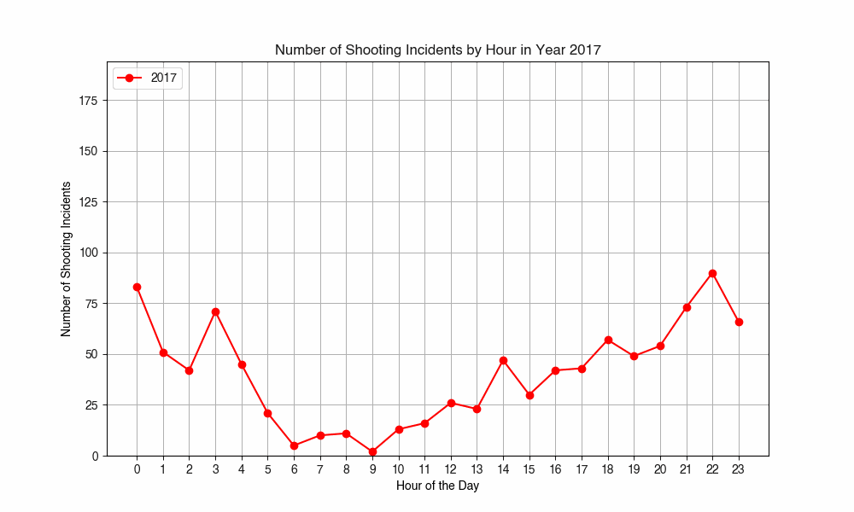
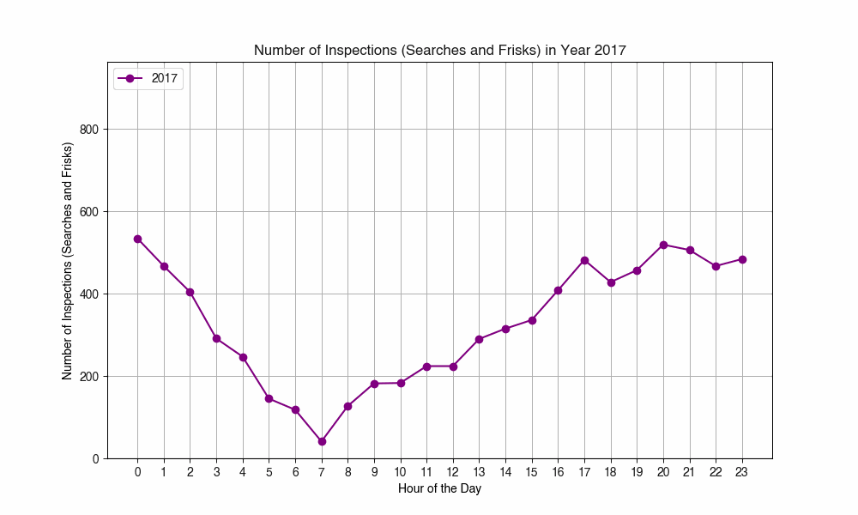
Key Findings & Insights: Crime Inspection
Correlation between No. of Shooting Incidents vs. No. of Crime Inspections in New York City during 2017-2022
Shooting Incidents in NYC (2017 - 2022)
Stop and Frisks in NYC (2017 - 2022)
Data-driven Inspection Pattern observed based on Shooting Incidents data
Source: New York Shooting Incidents Data, Stop, Question and Frisk Data (2017-2022)

Slide 11
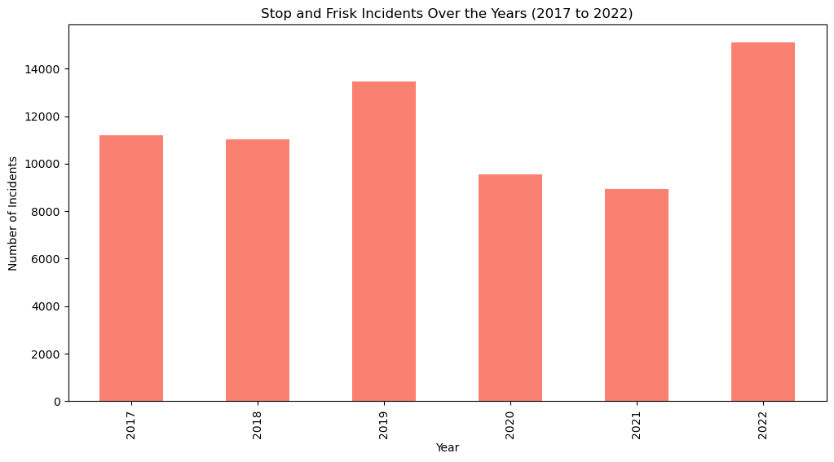
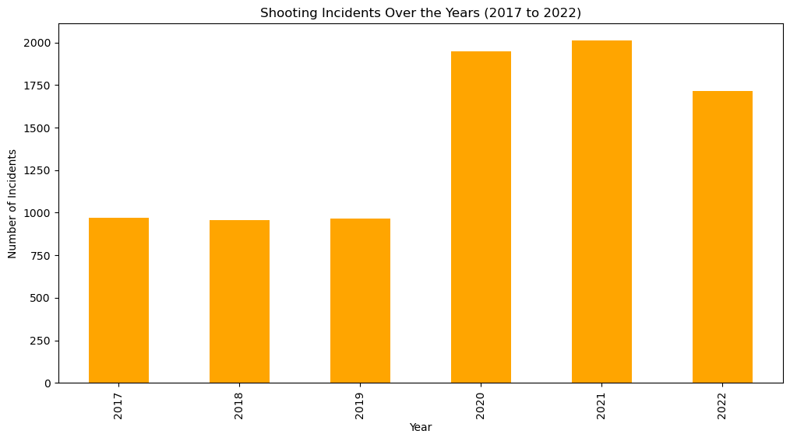
Effect of NYPD Inspections on Shooting Incidents
Correlation between No. of Shooting Incidents vs. No. of Crime Inspections in New York City during 2017-2022
Stop and Frisks in NYC (2017 - 2022)
Shooting Incidents in NYC (2017 - 2022)
Inverse correlation observed between Inspections and Shooting Incidents
Source: New York Shooting Incidents Data, Stop, Question and Frisk Data (2017-2022)

Slide 12
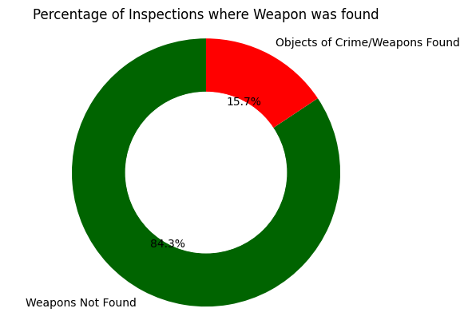
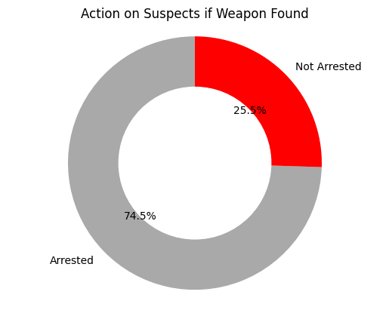
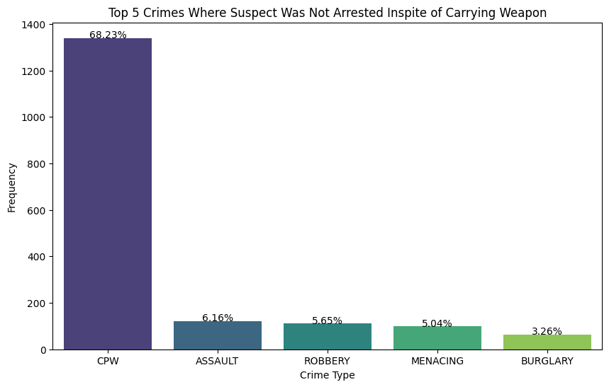
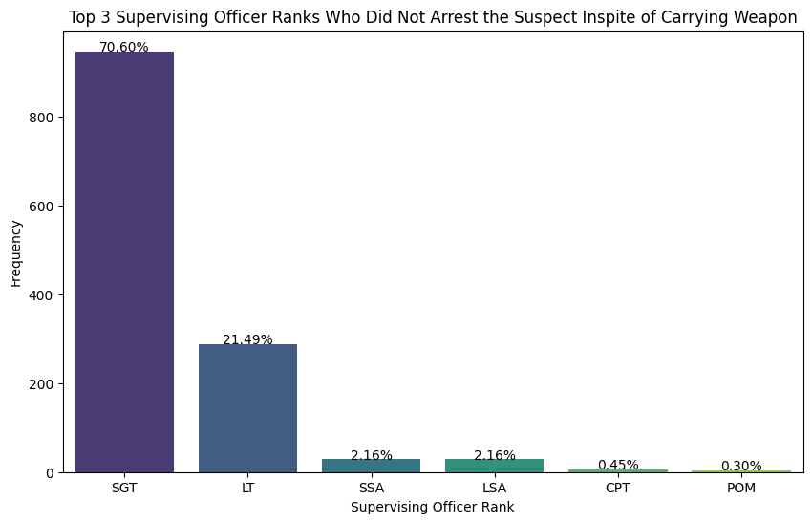
Drill Down Analysis on Inspections vs Arrest Data
15% of the inspections resulted in a weapon being found out of which only 75% of the suspects were arrested. Remaining 25% were not arrested.
~70% of the weapon-carrying non-arrested suspects had their crime described as CPW which is Criminal Possession of Weapon that results in a minimum sentence of 3.5 years if found guilty!
Additionally, ~70% of these non-arrested weapon-carrying suspects were let go by SGT (Sergeant) ranked officers.
Source: New York Stop, Question and Frisk Data

Slide 13
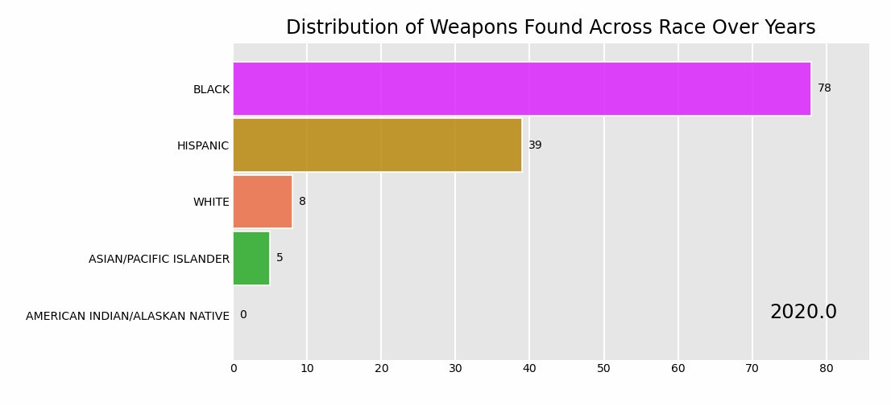
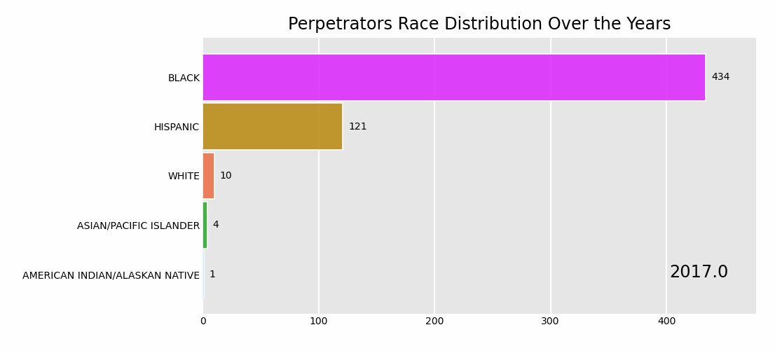
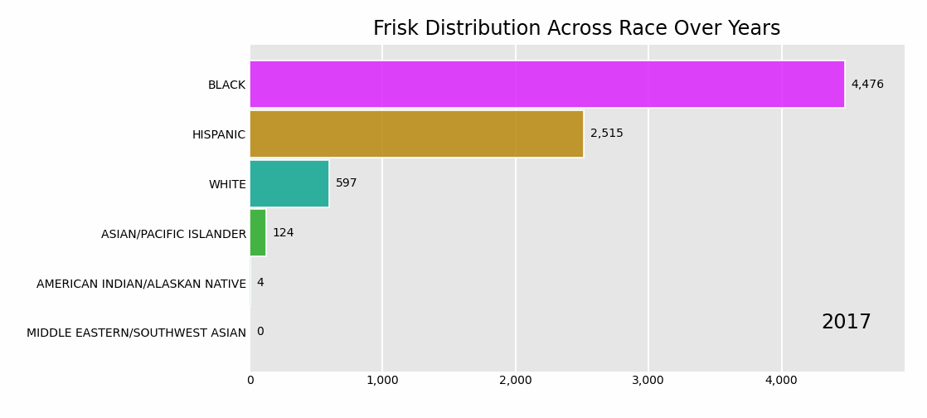
Year on Year Analysis of Race Distribution
Source: New York Shooting Incidents Data, Stop, Question & Frisk Data, Use of Force (Subjects and Incidents) Data (2017-2022)

Slide 14
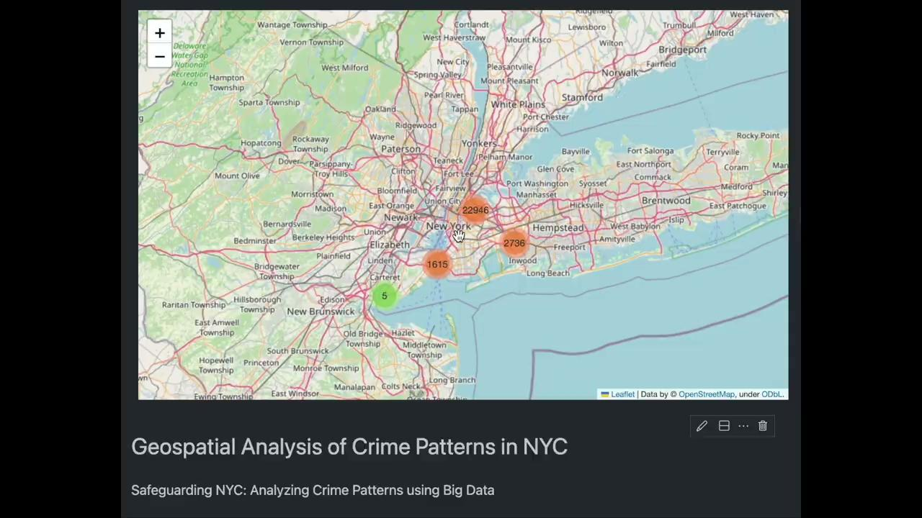
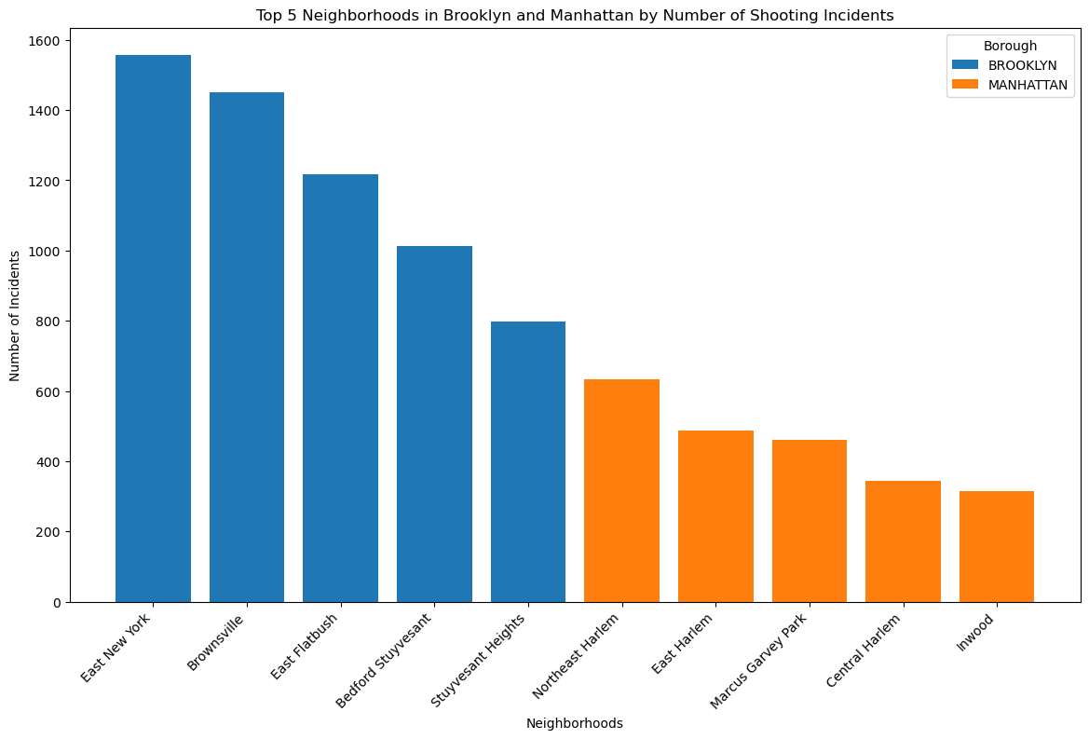
Neighborhoods with High Shooting Cases
Neighborhood | Shooting Increases (2017-22)
East Harlem | 190%
Brownsville | 116%
Central Harlem | 100%
East New York | 97%
Source: New York Shooting Incidents Data (2017-2022)

Slide 15
Challenges
Data Quality and Consistency: Ensuring the accuracy, completeness, and consistency of the data obtained from multiple sources was tricky.
Data Integration: Integrating diverse datasets from different sources, formats and time periods involved complex transformations.
Scalability: Handled large volumes of data without compromising on processing speed and efficiency using state-of-the-art tools such as Airbyte and Snowflake.
Data Provenance: Maintaining the entire flow of transformations made so that retracing and reproducing the results becomes easy
Handling Geospatial Data: Dealing with the complexities of geospatial data, including mapping and spatial analysis, to understand crime distribution and hotspots was challenging.

Slide 16
Conclusion
Through the analysis, we were able to successfully navigate complex crime and inspection data to derive meaningful insights.
We were able to establish robust end-to-end pipelines using GCP, Airbyte, and, Snowflake for efficient data ingestion, storage, transformation and processing.
Through our analysis, we also discovered critical crime trends, hotspots, and the effectiveness of NYPD current inspections.
Therefore, our analysis provides a comprehensive view of NYC crime patterns, which we believe will offer valuable insights for stakeholders and set a positive precedent for future urban safety analyses.

Slide 17
Thank You!
We are now open to questions.

